Slide 1


Social Impact Project ON
Breast Cancer
Awareness Program - A Case study Approach
BREAST CANCER
AWARENESS CAMP
with specific reference to Aristo Speciality Hospital, Madurai
OBJECTIVES
To study about how this program to be Promoted
To understand the attitude of the people who attendend the camp
To Study the effect of counselling
SOCIAL IMPACT PROJECT
Presented by: SANGEETHA L | MBA – Social Impact Project
Notes:
1

Slide 2



Research Methodology & Data Collection Tools
Qualitative method were used to capture real-life experiences and measure social impact across participants.
1. Observation Method
2. Interview Method
3. Case Study Method
  Participant behaviour during camp
  Emotional reactions before & after screening
  Counselling session interactions
  Family involvement & behavioural changes
  Semi-structured interviews with:
  Mrs. Meenakshi Sundaram, Doctors,
  Counsellors, Nurses & Family members
  Topics: Fear, Stigma, Finance, Awareness
  Detailed study of participant's journey
  Emotional, social & psychological analysis
  Financial & medical experience mapping
  Impact of counselling and awareness
Notes:
2

Slide 3

😟 Before the Camp
🏥 Medical Interaction
Fear of cancer diagnosis · Anxiety & social stigma · Hesitation due to past cancer deaths in community
Female counsellor provided comfort · Tamil-language communication · Emotional reassurance & trust-building
CASE STUDY
Mrs.
XXXXXXXXX
🔬 Medical Findings
🌟 Psychological Transformation
Small lump identified in clinical exam · Ultrasound: Benign fibroadenoma (BI-RADS Category 3) · Regular follow-up advised
Myths removed through counselling · Improved confidence · Began self-breast exams · Motivated neighbours to attend
Age: 43 | Homemaker
Villapuram, Madurai
Economically Vulnerable
No Prior Breast Exam
Notes:
3

Slide 4




Project Outcome & Social Impact
Medical Outcome
Psychological Impact
  Benign fibroadenoma – benign diagnosis confirmed
  Early detection prevented complications
  Successful monitoring plan established
  Reduced fear and emotional stress
  Increased confidence & healthcare awareness
  Overcame stigma & myths around cancer
Social Impact
Financial Impact
  Family became supportive post-camp
  Community awareness significantly improved
  Preventive healthcare behaviour encouraged
  Free diagnosis provided at the camp
  Hospital support for govt. health schemes
  Reduced financial burden on family
Overall: Improved healthcare accessibility · Women empowerment through awareness · Importance of community outreach programs
Notes:
4

Slide 5
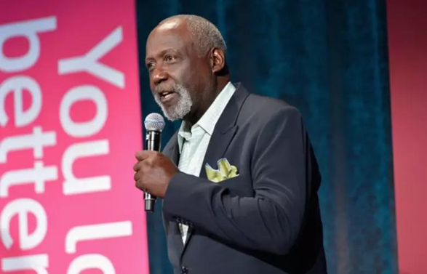
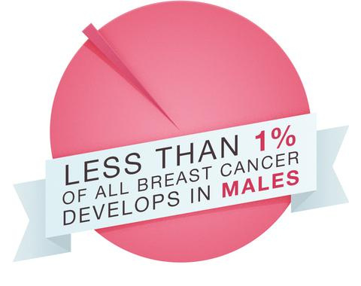

Richard Roundtree
  Diagnosis
In 1993, Richard Roundtree found a lump in his chest and was diagnosed with male breast cancer.
  Treatment & Recovery
He underwent surgery and chemotherapy and recovered successfully.
  Awareness
He shared his story to spread awareness that men can also get breast cancer.
  Social Impact
His story encouraged early diagnosis and reduced stigma about male breast cancer.

Slide 6


Conclusion
Breast cancer awareness camps play a vital role in early detection and prevention of the disease.
Counselling and emotional support are equally important as medical treatment for cancer patients.
Aristo Speciality Hospital successfully created social impact through community healthcare outreach.
The project highlights the importance of awareness, accessibility, and community healthcare services.
Community-based healthcare programs can transform lives and significantly improve women's health outcomes.
"Early detection saves lives, but awareness gives women the courage to seek help."
Presented by: [Your Name] | Social Impact Project – MBA | Aristo Speciality Hospital, Madurai
Notes:
5

